Slide 1
Ending Abortion
How and Why Through Dialogue
Trevor Pollo, Protect Life MI

Slide 2
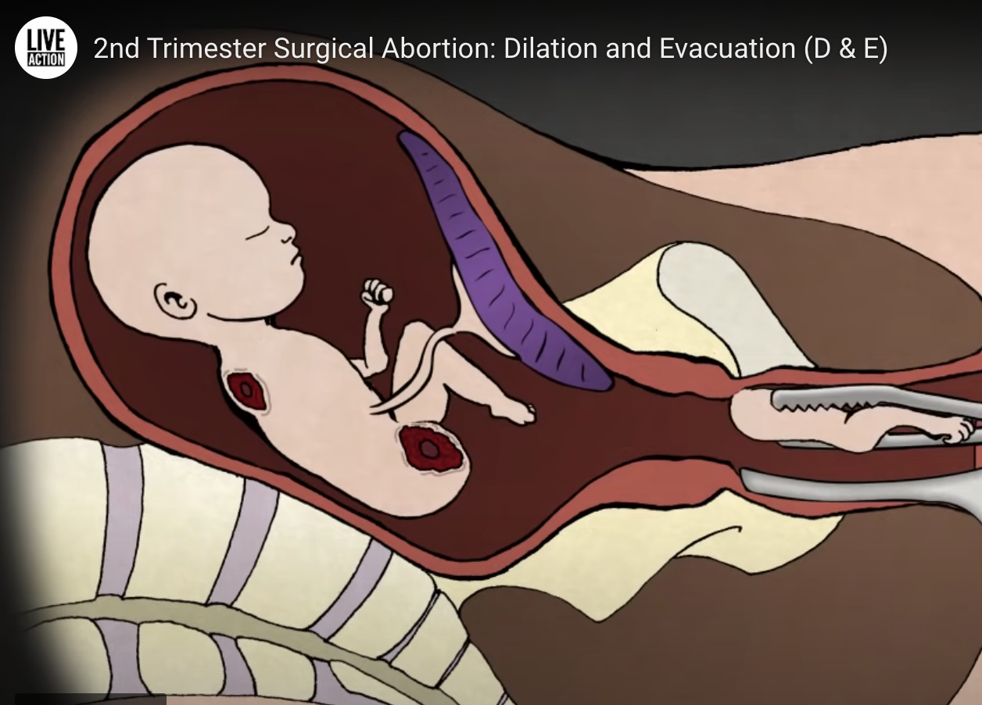
Why This Matters
Abortion is the most significant injustice of the past 50 years, as shown by:
The Victim
The Scale
The Consequence
The Suffering
A rate of life taken never before replicated in human history.

Slide 3
We Want to Make Abortion:
Unlawful | Unthinkable | Unnecessary
The intentional killing of innocent human beings should never be legal. The role of government is to protect the vulnerable, an allow the law to be a moral teacher. | The culture of our day lies to women when it says you are not strong enough or capable enough to be pregnant and go to school, pursue a career, or face your family. | We need to fill the gap for women when they feel like abortion is their only option. We should do everything we can for women in those situations. The only thing we cannot do, is kill.

Slide 4
Frame the Argument
We need to help people who support abortion, see it as an injustice.
That is why we need to approach it from their worldview, not our own
The most effective way to do so is to frame your argument as one that emanates from a position of:
Human Equality
Human Rights
Non-Violence

Slide 5
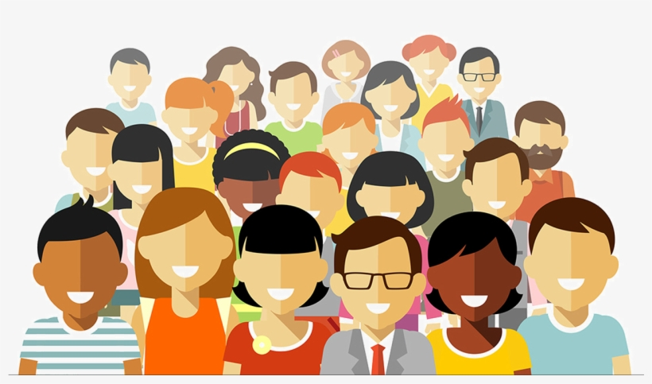
The Human Rights Argument
Our rights must be grounded in something we all share, at all time, equally
If we all share this thing equally, then we all are a part of the same human family and possess the same fundamental rights
The only thing that meets that qualification for where our rights come from, is our shared humanity

Slide 6
Preventing Dehumanization of the Vulnerable
Humanity always finds a way to “other” or dehumanize certain groups of people
Just like it was and continues to be wrong to do so based on race, religion, gender, etc., it is also wrong to do so on the basis of:
SIZE
LEVEL OF DEVELOPMENT
ENVIRONMENT
DEGREE OF DEPENDANCE

Slide 7
How we carry out this method

Slide 8
Questions?

